Slide 1


Slide 2


Slide 3
Case Study Presentation On Gall Bladder Polyp
Prepared By: Aakriti Poudel
Bsc nursing 2nd year, BHNC

Slide 4
Background
This case study report is prepared on “Gall Bladder Polyp” on the basis of a case study which I had taken during our 8 weeks of Medical Surgical Nursing Practicum in the Bir Hospital.According to the curriculum, we have to undertake one specific disease for case study and provide comprehensive and holistic nursing care to the patient by applying knowledge of basic science, nursing theories and process. It aims to enable the BHNC students to get knowledge about disease and its management.
As a result, I was able to gain a comprehensive knowledge about this disease and management as well as care of patients. While handling this case, I got the opportunity to deal with the patient with this disease condition. It was a great experience.

Slide 5
Background contd..
I have selected Mr. Kedar Bhetwal for my case study. He has a history of sharp, intense and diffuse pain in abdomen. He was admitted with the diagnosis of gall bladder polyp.
I have gathered a comprehensive patient history, explored the ramifications of his condition, and delved into the disease management strategies. Throughout, I've nurtured a trusting bond with the patient, conducted thorough physical assessments, and extensively consulted various sources: books, websites, and pertinent factors, to ensure the highest quality of care. My approach has been holistic, addressing all aspects of the patient's well-being during his hospital stay.
This type of in-depth study enhances student nurse ability to apply theoretical knowledge on a practical basis.

Slide 6
Rationale For Selection of Case
Polypoid lesions of the gallbladder affect approximately 5% of the adult population. The causes are uncertain, but there is a definite correlation with increasing age and the presence of gallstones. Most affected individuals do not have symptoms. The gallbladder polyps are detected during abdominal ultrasonography performed for other reasons.[
The overall prevalence among men of Chinese ancestry is 9.5%, higher than other ethnic types.
Found mostly on abdominal ultrasound, the prevalence of GB polyps is 0.3%-9.5% . Found mostly in men with a male to female ratio of 1.15:1, they are commonly detected at the age of 49 . Almost 70% of the polyps are pseudopolyps. Approximately 178100 cases of GB carcinomas are reported every year with the highest incidence seen in South America and Asia. It is relatively uncommon in North America and the USA .

Slide 7
Rationale Cont’d….
Likewise, cases of gall bladder polyp admitted in Post operative ward of bir hospital is 5 in June and july 2024.
So, I selected this case of gall bladder polyp for study to go to depth and gain knowledge about it by correlating the disease according to book and patient in real practical situation. After gaining deep knowledge about gall bladder polyp and cholecystectomy, I can help clients in hospital as well as community. I can generate awareness about gall bladder polyp in community to prevent it and refer client with it’s symptoms to hospital. Therefore, I am interested to be known with gall bladder polyp and selected this case .

Slide 8
General Objective
Objectives
To provide holistic care to patient through nursing process using appropriate nursing theories.

Slide 9
Specific Objectives
To gain knowledge about specific disease.
To identify the cause, clinical features and diagnostic evaluation of gall bladder polyp.
To establish rapport and gain the trust and co-operation of the patient and family members.

Slide 10
Specific Objectives Cont’d….
To gather factual health assessment and perform proper assessment of the patient.
To gain new facts and ideas about the disease.
To gain better and clearer understanding on the nature, course, physical and emotional changes and signs and symptoms relevant to this disease.

Slide 11
Specific Objectives Cont’d….
To disseminate information to the patient as well as her relative about the illness and how to care for the patient.
To evaluate daily progress of patient health and effectiveness of treatment.
To minimize the stress of the patient and her family by providing adequate information and using appropriate diversion therapy.

Slide 12
Specific Objectives Cont’d….
10. To be able to formulate related nursing diagnosis from the patient health data and the current problems, the patient was experiencing and to come out with different nursing interventions effective for the patient to improve and progress on the most possible time.

Slide 13
Specific Objectives Cont’d….
To involve patient and her family members in discharge planning and follow up visits.
To get the information about the topic related research and compare to book picture and patient.

Slide 14
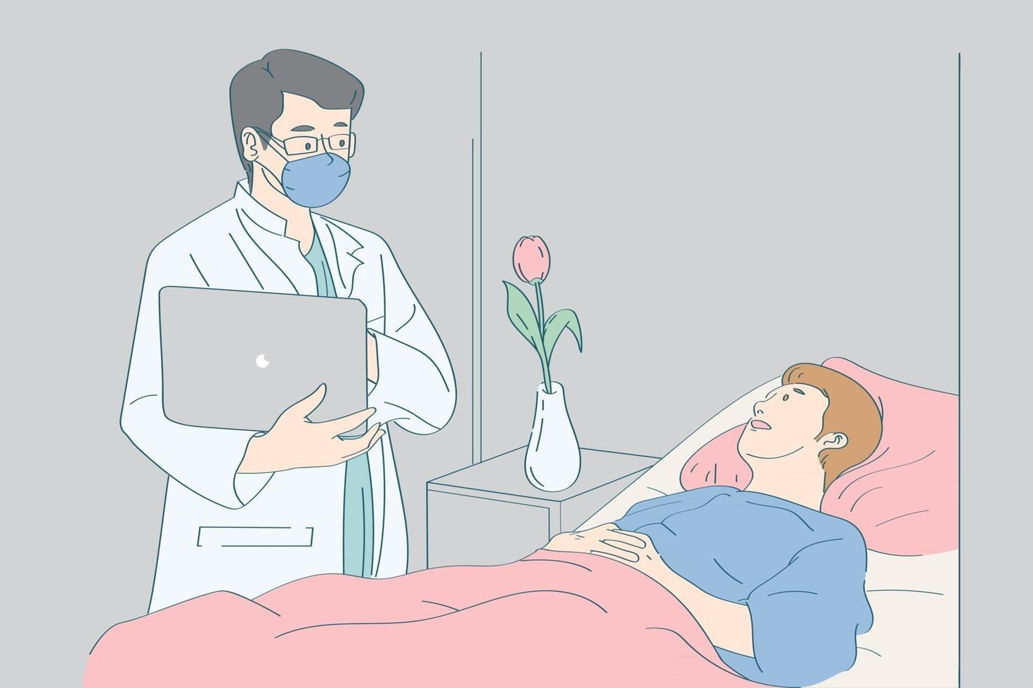
History Taking

Slide 15
1. Socio-demographic data
Name: Kedar Bhetwal
Age: 75 years
Sex: Male
Address: Chitwan
Religion: Hindu
Occupation: Farming
Education: 2 class completed
Marital status: Married
No. of children: 5 (4daughters and 1 son)

Slide 16
Ward: Male surgical ward
Bed no: 351
IP No.: 229370
Blood group: ‘O’ positive
Date of admission: 2081/04/27
Date of Surgery:2081/04/28
Date of discharge: 2081/04/31
Duration of female medical ward: 5 days

Slide 17
Provisional Diagnosis: Gall bladder polyp
Operative Procedure: Laparoscopic cholecystectomy
Surgeon: Dr Rishi Kanta
Anesthesiologist: Dr GA
Name of Scrub Nurse: RN Nirmala
Name of Floor Nurse: RN Anita
Date of History Taking: 2081/04/27
Informant: Patient and his daughters

Slide 18
2. Chief Complaints
According to the patient, she said that:
Pain abdomen since 6 months
Abdominal fullness or bloating since 2 days

Slide 19
3. History of present illness
The patient is a 75 year old male who present with complaints of intermittent right upper quadrant abdominal discomfort over the past 6 months. He describes the pain as dull and non-radiating. The discomfort has been gradually increasing in frequency, though it remains mild in intensity. He reports occasional bloating and indigestion, particularly after eating fatty or heavy meals. He denies any significant nausea, vomiting or changes in bowel habits. There has been no fever, chills or signs of infection. The patient also denies any unintentional weight loss, jaundice or changes in the color of his stool or urine.

Slide 20
4. Recent Treatment History
Inj. Pantacid 40mg IV BD
Inj. PCM 1 gm IV QID
Inj keterol30mg IV TDS
Inj xone 1gm IV BD
Inj pethidine 25mg + phenargan 12.5mg IV SOS

Slide 21
5. History of past illness
He was known case of hypertension and was under medication (Tab. amlodipine-5mg) since 5 years.
6. Childhood illness
No any childhood illness

Slide 22
7. Immunization History
S. N. | Age | Immunization | Taken | Not taken
1 | Birth | BCG
2 | 6, 10 & 14 weeks | DPT, Hep B, Hib B and OPV
3 | 6, 10 weeks & 9 months | PCV
4 | 9 months & 15 months | Measles, Rubella
5 | 12 months | Japanese Encephalitis

Slide 23
8. History of drug allergy
No any history of drug allergy
9. History of any chronic illness
Patient was known history of hypertension since 5 years.
10. History of Surgery
No previous surgeries.
11. History of Previous Hospitalization
none

Slide 24
Family History
Disease | Paternal Side | Maternal Side
Diabetes | father | no
Cancer | no | no
COPD | no | no
Cardiovascular disease | no | no
Infectious disorder | no | no
Genetic disorder | no | no

Slide 25
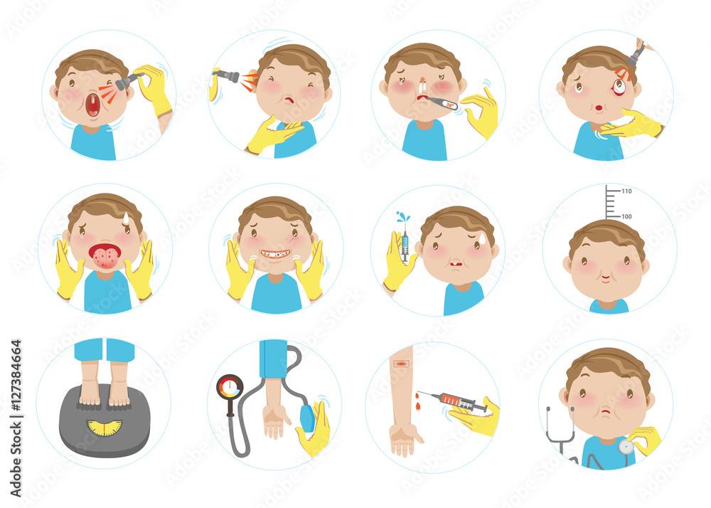
Physical Examination

Slide 26
Physical Examination
On 2081/04/27, I performed physical examination of the patient.
I used following methods to perform physical examination:
Inspection
Palpation
Percussion
Auscultation

Slide 27
Findings of physical examination
General appearance seemed composed but facial expression showed a little worried, tired look
Use of spectacles of power (+3) due to low vision
Presence of dental carries
Use of accessory muscles during breathing

Slide 28
Findings Cont’d….
Resonant sound present in both lungs during percussion of chest
Presence of bowel sound
regular bowel movement

Slide 29
Developmental Task
Mr kedar Bhetwal is 75 years old female and belongs to older adulthood.
The developmental crisis of older adulthood is “Ego integrity Vs. Despair”.

Slide 30
Developmenal task | description
Adjusting to Retirement | Patient is well adjusted to retirement and enjoys his life performing recreational activities like gardening, watching television and listening to bhajan.
Coping with Physical Decline | He completely manages age-related health issues and physical limitations, and adapts to changes in physical abilities
Maintaining a Sense of Identity | Preserving self-worth and identity despite changes in role and physical abilities.
Dealing with Loss | Handles loss of peers, family members, and friends, and manages feelings of grief and loneliness
Establishing a Legacy | Reflecting on one’s life contributions and values, and passing on wisdom and experiences to younger generations
Adjusting to Changing Social Roles | Adapting to shifts in family roles, such as becoming a grandparent or dealing with changes in family dynamics.

Slide 31
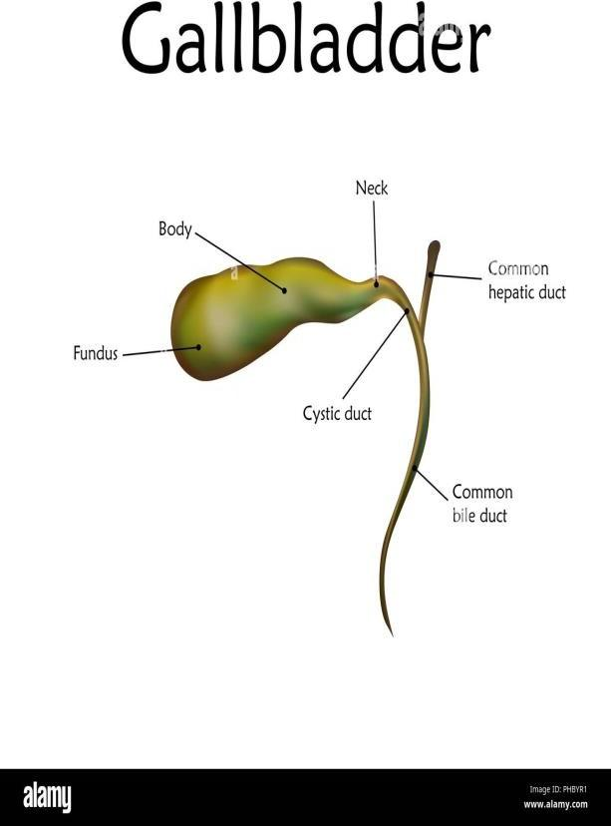
Anatomy and physiology

Slide 32
Definition
The gallbladder is a pear shaped sac attached to the posterior surface of the liver by connective tissue. It is a thin walled, green muscular sac about 06 cm long. It has a fundus (expanded end), a body (main part) and neck (narrowing part) which is continuous with the cystic duct. Its capacity is approximately 60ml.

Slide 33
Structure
The gall bladder consists of three coats:
a. Peritoneum: It is continuous with peritoneum covering the liver, which binds the gallbladder in position on the under surface of the liver.
b. Muscle layer: The muscular layer consists of layers of smooth muscle with longitudinal, oblique and circular fibers.
c. Mucous membrane: The inner lining is of mucous membrane, which displays very small rugae when the gallbladder is empty. The rugae disappear when the organ is distended with bile.

Slide 34
Blood supply: The cystic artery, a branch of the hepatic artery, supplies blood to the gallbladder. Impure blood is drained away by the cystic vein into the portal vein.
Nerve supply: Nerve impulses are conveyed by sympathetic and parasympathetic nerve fibers.

Slide 35
Functions
It acts as a reservoir for bile. Its capacity is approximately 60ml.
The lining membrane adds mucus to the bile.
It absorbs water so that it is 06 to 15 times more concentrated than liver bile.
By the contraction of the muscular walls, bile is expelled from the gallbladder and passed via the bile ducts into the duodenum. The sphincter of oddi must relax before bile can pass into the duodenum. Fat, the acidity of chyme in the duodenum and the hormone.

Slide 36
Ductal system
Ductal system provides a route for bile to reach the intestines. Bile is formed in the liver and excreted into the hepatic duct. Hepatic duct joins with the cystic duct to form the common bile duct. The hepatic ducts deliver bile to the gall bladder via the cystic duct. The hepatic ducts deliver bile to the duodenum via the common bile duct. The common bile duct opens into the duodenum, with the pancreatic duct at the ampulla of Vater. The sphincter prevents the reflux of intestinal contents into the common bile duct and pancreatic duct. The sphincter of Oddi guards the entrance into the duodenum and if contracted, bile is stored in gallbladder.

Slide 37
Bile
The bile, which is secreted by the hepatocytes (cells of liver) and flow through the hepatic ducts, is called 'liver bile' whereas the bile that is released (evacuated) from the gallbladder and conveyed by the common bile duct to the duodenum is called gallbladder bile. After forming the bile in liver, it passes down the hepatic duct and the bile ducts, but is unable to enter the duodenum because sphincter of oddi is closed, therefore, it passes along the cystic duct to the gallbladder for storage and concentration. When meal has been taken, the hormone cholecystokinin, produced by the wall of duodenum, stimulates gallbladder to contract and viscid, greenish fluid, bile is ejected towards duodenum.

Slide 38
Composition of bile
Water - 97%
Bile salt (cholic acid, chenodeoxycholic acid, deoxycholic acid and lithocolic acid) - 0.7%
Bile pigments (bilirubin, biliverdin) - 0.2%
Cholesterol - 0.06%
Inorganic salts - 0.7%
Fatty acids - 0.7%
Lecithin - 0.1%
Fat - 0.1%
Mucus
Alkaline phosphate

Slide 39
Function of bile
Most of the function of bile is due to bile salts. Following are the major functions:
They are necessary for digestion and absorption of fats.
Bile pigments are the waste products of the breakdown of the red blood cells and bile is their route of excretion.
The presence of bile in the small intestine is necessary for the absorption of vitamin K and digested fat.
Bile colors and deodorizes the feces.
Bile has an aperient (mild laxative or purgative) action.
Bile salts keep cholesterol in solution in the bile.
It has mild antibacterial action.

Slide 40

Disease Profile

Slide 41
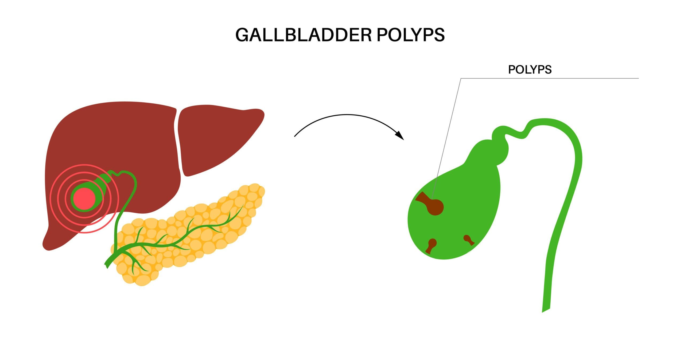
Gall bladder polyp

Slide 42
Definition
Gallbladder Polyp
A gallbladder polyp is a localized, abnormal growth or lesion that extends from the mucosal lining of the gallbladder. Unlike gallstones, which are solid particles, polyps are tissue-based formations that can vary in size and appearance. They are typically detected during imaging studies, such as an ultrasound, performed for other reasons.

Slide 43
Types
Cholesterol Polyps
Description: These are the most common type and are benign. They result from the accumulation of cholesterol deposits within the gallbladder lining.
Appearance: Often appear as small, flat lesions with a smooth surface on ultrasound.
Adenomas
Description: These are glandular tumors that can be benign but have the potential to be precancerous. They are less common than cholesterol polyps.
Appearance: May have a more irregular shape and can vary in size. Larger adenomas (greater than 1 cm) carry a higher risk of malignancy.
Inflammatory Polyps
Description: These arise due to chronic inflammation of the gallbladder, such as in chronic cholecystitis (long-term inflammation of the gallbladder).
Appearance: Often associated with signs of inflammation on imaging.

Slide 44
Epidemiology
Prevalence: Found mostly on abdominal ultrasound, the prevalence of GB polyps is 0.3%-9.5% . Found mostly in men with a male to female ratio of 1.15:1, they are commonly detected at the age of 49 . Almost 70% of the polyps are pseudopolyps. Approximately 178100 cases of GB carcinomas are reported every year with the highest incidence seen in South America and Asia. It is relatively uncommon in North America and the USA .
Age: More common in individuals over 40 years of age.
Gender: Slightly more prevalent in women.

Slide 45
Etiology
S.N. | According to Book | In my Patient
1. | Gender (Male: Female :- 1:4) | Male
2. | Age (>40 years) | Present 75 years
3. | Diabetes | Absent
4. | Cholesterol accumulation | present
5. | Gastrointestinal disease | absent
6. | Rapid weight loss | absent
7. | Genetic predisposition | absent

Slide 46
Pathophysiolgy

Slide 47
Clinical features of gall bladder polyp
S.N. | According to Book | In my Patient
1. | -Nausea and Vomiting | - Absent
2. | -Indigestion | - Absent
3. | -Epigastric distress such as fullness after eating | - Present
4. | -Pain in right upper quadrant of abdomen | Present
5. | -Pain in right upper quadrant of abdomen radiating to both or right shoulder | absent
6. | -Fever and tachycardia | absent
7. | -Jaundice | Absent
8. | dyspepsia | Absent

Slide 48
Diagnostic investigations
IN BOOK | IN PATIENT
History taking | done
Physical examination | done
ultrasound | done
Blood tests | done
ECG | done

Slide 49
In my patient
History Taking
He had a history of hypertension and is under medication for 5 years.
Physical Examination
Tenderness felt over abdomen.
Ultrasound of abdomen/pelvis report
Gall bladder: a sessile broad band polyp measuring 12*5mm is noted attached to anterior gall bladder wall. Presence of soft gall bladder calculus.
Prostate: enlarged
ECG (2081/04/21)
Laboratory investigations

Slide 50
Hematology
Complete blood count
Tests | Result | Reference value
WBC | 9600 | (4-11 x000) mm³
RBC | 4.81 | (4-6.5)mil/ mm³
Platelets | 197000 | (150-500 x 10^{^ 3}) mm³
Neutrophils | 53 | (40-75) %
Lymphocytes | 38 | (20-45) %
Eosinophils | 04 | (1-4) %
Monocytes | 05 | (2-6) %
Basophils | 00 | (0-1)%
Hemoglobin | 13.4 | (11-18) gm/dl
PCV | 41.4 | (35-54) %

Slide 51
Biochemistry
Blood sugar random | 95 mg/dl | 70-140 mg/dl
RENAL FUNCTION TEST
Tests | Value | Reference value
Urea | 21 | (20-40)mg%
Creatinine | 1.0 | (0.4-1.4)mg%
Sodium | 142 | (135-155)mmol/l
Potasium | 4.3 | (3.5-5.5)mmol/l

Slide 52
Liver Function Test
Serum bilirubin(total) | 0.5 | 0.4- 1.0 mg%
Serum bilirubin (Direct) | 0.2 | <0.4 mg%
Alkaline Phosphate | 53 | 42-98 U/L
SGOT | 23 | 5.0- 40.0 U/L
SGPT | 21 | 5.0- 35.0 U/L
Protein | 7.7 | 6-8 gm%
Albumin | 4.8 | 3.4-4.8 mg%

Slide 53
Hematology Test
Immunology Test
Blood Group | A positive
Bleeding time | 2 minute 30 second | 1-6 minute
Clotting time | 5 minute 30 second | 5-11 minute
HIV | Negative
HBSAG Test | Negative
Prothrombin Time | 12.6 | 12-16 second
INR | 0.97

Slide 54
URINE REPORT ANALYSIS
PHYSICAL EXAMINATION:-
Color: Light Yellow
Transparency: Clear
Reaction: Acidic
CHEMICAL EXAMINATION:-
Albumin: Nil
Sugar: Nil
MICROSCOPIC EXAMINATION:-
RBC : Not seen
Pus cells: 0-1
Epithelial : 1-2
Others : Not seen

Slide 55
Treatment
1. Symptomatic Management
a. Pain Relief:
Analgesics: Over-the-counter pain relievers such as acetaminophen (Tylenol) or nonsteroidal anti-inflammatory drugs (NSAIDs) like ibuprofen (Advil) can be used to manage any associated pain or discomfort.
Prescription Medications: In cases of severe pain, a healthcare provider may prescribe stronger analgesics or pain management strategies.
b. Anti-Inflammatory Medications:
NSAIDs: May be used to reduce inflammation if the polyps are causing gallbladder inflammation or irritation.

Slide 56
2. Management of Associated Symptoms
a. Gallbladder Inflammation or Spasm:
Antispasmodics: Medications such as hyoscine butylbromide (Buscopan) can help relieve gallbladder spasms.
Cholestyramine: In some cases, this medication may be used to manage bile acid-related symptoms, though it does not affect the polyps directly.
b. Digestive Health:
Bile Acid Supplements: These might be used to manage symptoms related to bile flow, especially if there are issues with digestion due to gallbladder problems

Slide 57
Surgical Management
Laparoscopic cholecystectomy: Laparoscopic cholecystectomy is a minimally invasive surgical procedure used to remove the gallbladder. It's commonly performed to treat conditions such as gallstones, cholecystitis (inflammation of the gallbladder), and in some cases, gallbladder polyps. It was done in the patient.

Slide 58
Nursing Management
Nursing assessment
Patient history:
Symptoms: Assess the symptoms that could be related to gallbladder issues, such as abdominal pain (especially in the upper right quadrant), nausea, vomiting, bloating, or changes in bowel habits.
Duration: Inquire about how long the symptoms have been present.
Review risk factors such as obesity, diabetes, a history of gallstones, or a family history of gallbladder disease.

Slide 59
b. Physical Examination
Abdominal Examination: Palpate the abdomen to assess for tenderness, especially in the right upper quadrant where the gallbladder is located. Note any signs of pain or discomfort.
Other Signs: Look for signs that might indicate complications, such as jaundice (yellowing of the skin or eyes), which can occur if a polyp obstructs bile flow.

Slide 60
c. Diagnostic Tests
Ultrasound: The primary imaging test for gallbladder polyps. Assess the size, number, and appearance of the polyps. Most gallbladder polyps are benign and detected incidentally.
CT Scan/MRI: May be used for further evaluation if there are concerns about malignancy or if the ultrasound results are inconclusive.

Slide 61
Nursing diagnosis
Actual Nursing diagnosis
Acute pain related to presence of gall bladder polyps causing inflammation or obstruction as evidenced by guarding positioning and patient reports of dull, aching right upper quadrant pain.
Altered body temperature related to inflammatory response following surgery as evidenced by body temperature above the normal range i.e. 102.3 degree Fahrenheit.
.

Slide 62
Impaired physical mobility related to postoperative pain, surgical incision as evidenced by difficulty in moving, reluctance to change position etc.
Ineffective therapeutic regimen management related to lack of knowledge on post operative and home care management as evidenced by self verbalization by patient and anxiousness.
Disturbed sleep pattern related to noisy environment as evidence by patient verbalization in difficulty sleep.
Potential Nursing diagnosis
- Risk for infection related to dust from locker, prolonged hospitalization

Slide 63
Nursing Intervention
Relieving pain:
a. Assess the pain level
b. Asses vital signs
c. Maintain comfortable position
d. Use diversional therapy
e. Provide pain medication

Slide 64
2. Relieving hyperthermia
Assess the vital signs i.e. temperature, BP, pulse, oxygen saturation, respiration rate.
Tepid sponging for 20 minutes in forehead, hands, feets etc
Maintain fluid intake and soft diet.
Provide antipyrectics as prescribed.

Slide 65
3. For impaired physical mobility
Plan activity and period of rest which are within patients' ability.
Assist the patient to perform active and passive range of motion exercise on bed.
Assist with position change
Encourage early ambulation.

Slide 66
4. Reduce anxiety:
a. Access the general condition
b. Explain the surgical procedure using simpler language
c. Show nearby cases of successful surgery.

Slide 67
5. Provide education
a. Review underlying disease process and recovery expectations
b. Provide opportunity for questioning and answer them honestly
c. Involve client in decision making
d. Counsel about conservative management and later follow up.

Slide 68
Perioperative Management
Preoperative Management:
Preoperative assessment
Psychological preparation
Operation consent
Preoperative teaching
Physical preparation
Premedications

Slide 69
Post operative Management
It refers to the care after surgery to complete healing of wound/incision of the patient. It includes mainly the following nursing cares;
a. Receive the patient in warm and comfortable bed.
b. Position the patient in supine with face turned to one side.
c. Assess the level of consciousness and orientation to time, place and person and assess ability to move extremities.
d. Assess the vital signs every ½ hourly, 2-4 hours depending upon the improvement in the condition of the patient then every 4 hourly.

Slide 70
e.Check intravenous infusion rate frequently.
f. Give medicines according to doctor’s instruction and record it properly.
g. Observe for post-operative complications.
h. Monitor amount of urinary output. Palpate for bladder distension. (At least 30ml per hour.)
i. Encourage deep breathing, foot and leg exercise as soon as possible, usually within 24 hours.
j. Assist in position change.
k. Ambulation on first post-operative day.
l. Record the client’s time of arrival and all assessment record, intake output including any oral fluid, IV fluid as well as drainage, voiding and emesis.

Slide 71
Evaluation
a. Pain reduced
b. Knowledge increased about disease condition, treatment, surgical procedure and prognosis
c. Anxiety reduced
d. Activity intolerance increased
e. Able to apply infection prevention measures

Slide 72
Complications
According to book | In patient
Hemorrhage | absent
Cholangitis | absent
Pancreatitis | absent
Secondary biliary cirrhosis | absent
Peritonitis | absent
Infection at surgical site | absent

Slide 73
Preventive measures
There is no proven way to prevent gall bladder polyp, but research suggests some possibilities:-
Eat well balanced meals daily.
Maintain normal weight.
Get regular exercise (at least 30 minutes a day).

Slide 74
Prognosis
The prognosis of a gallbladder polyp is generally good, particularly for small, asymptomatic polyps.
Larger polyps or those with concerning features require more careful evaluation to rule out malignancy and decide on appropriate treatment.
Regular follow-up and monitoring are crucial to manage and address any changes in the polyp's characteristics or symptoms

Slide 75

Drugs profile

Slide 76
Drugs used in my patient
Name of drug | Dosage | Route | Frequency | Indications
Injection pantacid | 40mg | IV | BD | To reduce the production of stomach acids.
Injection PCM | 1gm | IV | QID | For fever and pain
Injection keterolac | 30mg | IV | TDS | Pain
Injection xone | 1gm | IV | BD | Infection prevention
Injection pethidine | 25mg | IV | SOS | Pain
Injection phennargan | 12.5mg | IV | SOS | Pain

Slide 77

Application of Nursing Theory

Slide 78
Virginia Henderson’s Independent Theory of Nursing.
Henderson’s Theory
Henderson considers the biological, psychological, sociological and spiritual components. She
proposed 14 basic needs for patients. The 14 components of nursing functions are closely parallelof Abraham Maslow. The first 7 components are physiological, 8 and 9 relate to safety, 10 relate to love and belonging and 11 and 14 relate to self-actualization. In comparison with Henderson’s 14 basic needs, my patients have the following needs.

Slide 79
14 Components | My Patient’s Condition
1. Breathe normally. | 1. Able to breathe normally
2.Eat & drink adequately | 2. Adequately.
3. Eliminate body wastes. | 3. Able to eliminate body waste.
4. Move & maintain desirable posture | 4. Able to move & maintain desirable posture and position.
5.Sleep & rest | 5. not able to sleep due to pain.
6. Select suitable clothes, dress & undress. | 6. Able to select suitable clothes.
7. Maintain body temperature within the normal range by adjusting clothing & modifying the environment. | 7. He had a fever on the fourth day(102.3 degree Fahrenheit)

Slide 80
8. Keep the body clean & well groomed & protect the integument. | 8. Adequately.
9. Avoid danger in the environment & avoid injuring others. | 9. Can avoid danger in the environment
10. Communicate with others in expressing emotions, needs, fears or opinions. | 10. Adequately.
11. Worship according to one’s faith. | 11. Worships god according to Hindu religion & have faith in it.
12.Work in such a way that there is a sense of accomplishment | 12. He accomplished his work in the normal time limit.
13. Playing or participating in various forms of recreation | 13. Not fulfilled due to disease conditions.
14. Learn, discover or satisfy the curiosity that led to normal development of health & use of available health facilities. | 14. Cannot satisfy curiosity due to lack of knowledge.

Slide 81
Nursing Diagnosis
Actual Nursing diagnosis
Acute pain related to presence of gall bladder polyps causing inflammation or obstruction as evidenced by guarding positioning and patient reports of dull, aching right upper quadrant pain.
Altered body temperature related to inflammatory response following surgery as evidenced by body temperature above the normal range i.e. 102.3 degree Fahrenheit.
Impaired physical mobility related to postoperative pain, surgical incision as evidenced by difficulty in moving, reluctance to change position etc.

Slide 82
- Ineffective therapeutic regimen management related to lack of knowledge on post operative and home care management as evidenced by self verbalization by patient and anxiousness.
- Disturbed sleep pattern related to noisy environment as evidence by patient verbalization in difficulty sleep.
Potential Nursing diagnosis
Risk for infection related to dust from locker, prolonged hospitalization.

Slide 83
Daily Progress Note
Date | Vital signs | Nursing report
2081/04/27 | T: 98ºF P: 90b/m R: 26b/m BP: 130/80 SpO₂: 91% in RA | Admission note: A 75-year male with diagnosis of gall bladder polyp was received from OPD at 10:00 Am on foot. Cannulization was done on left hand. - Patient complaint of abdominal pain which aggravated after meal. For management of this pain patient position was maintained and deep breathing and coughing exercise was taught.

Slide 84
Date | Vital signs | Nursing report
2081/04/28 | T: 97ºF P: 90b/m R: 22b/m BP: 140/80 SpO₂: 90% in RA | Patient was on NPO since 12AM. All preoperative procedure were performed like psychological preparation, physical preparation and OT consent was taken. Anxiety related to surgical procedure was removed as patient was taught about his disease condition, operative procedure, post operative care and post operative complications. Patient was taken to operation theater at 9 am.

Slide 85
Date | Vital signs | Nursing report
2081/04/29 | T: 98ºF P: 100b/m R: 22b/m BP: 130/80 SpO₂:91% in RA | Patient general condition seems weak since he complaint of pain at surgical site. No soakage at operative site. Pain present so pain management done. IVF NS I continue with 24 drops/minute. Patient was on soft diet after he can tolerate the soft food as he had taken only liquid diet after surgical procedure. Medication done as per cardex.

Slide 86
Date | Vital signs | Nursing report
2081/04/30 | T: 102.3ºF P: 88b/m R: 20b/m BP: 130/80 SpO₂: 92% in RA | He had fever of 102.3 degree Fahrenheit at 11AM. Tepid sponging was done. Inj pcm was administered to decrease the fever. Again after 2hrs temperature was taken and it was found to be 98.8 degree Fahrenheit. Medications were given as per cardex. Ambulation was done with the assistance of patients family. Range of motion exercise was taught to patient to promote circulation and aid in wound healing. Dressing was done using aseptic technique to prevent infections.

Slide 87
Date | Vital signs | Nursing report
2081/04/31 | T: 97ºF P: 90b/m R: 20b/m BP: 120/80 SpO₂: 93% in RA | Patient was on oral medications. Discharge teaching was also provided. Curiosity about the diet was cleared and ways to prevent infections was taught. Patient was advised to do dressing daily in nearby clinics and come for follow up on time.

Slide 88

Diversional therapy
Distraction
Relaxation technique
Talk therapy

Slide 89
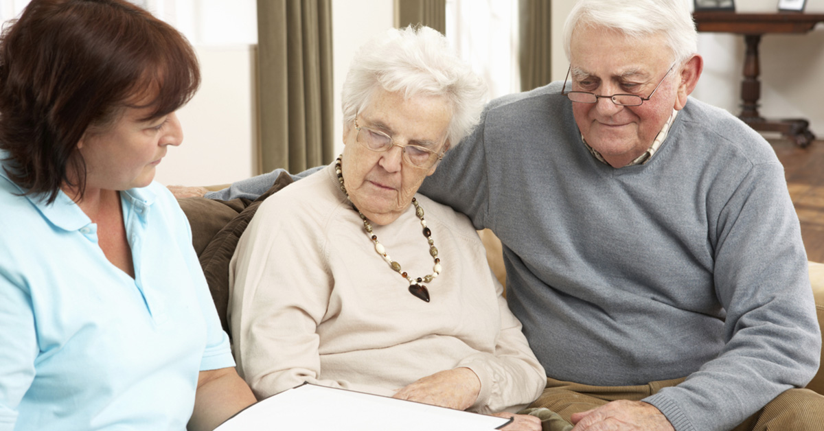
Discharge Teaching

Slide 90

1. Diet modification:
I suggested to provide high calorie and protein diet. 1 extra meal per day, including more soyabean, pulses, lentils, legumes and Vitamin C containing fruits like orange, lemon, amala to provide and meet the metabolic demand of the patient. I also instructed the client about dietary restriction, such as avoid spicy and take low fat diet and drink plenty of water.

Slide 91
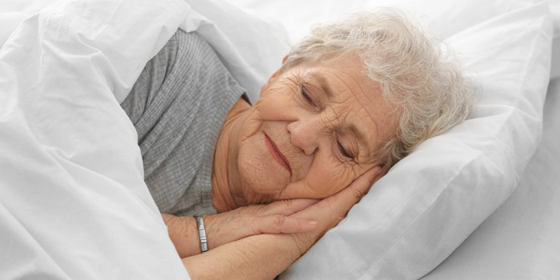
2. Rest and Activity
Patient should have adequate physical and mental rest. I advised visitors to maintain environment to promote sleep. I encourage the patient to ambulate frequently and avoid lifting heavy weight. I also focused on continuation of range of motion exercises and mild physical exercises.

Slide 92

3. Personal hygiene
Advised to maintain personal and environmental hygiene. Proper hand washing technique, wound care, proper disposal of waste products, infection prevention measures were taught. It is important to prevent from infection and to promote health

Slide 93
Medication and follow up visit
Tablet | Cefixime | 200mg | P/O | BD | for 5days.
Tablet | Pantop | 40mg | P/O | BD | for 7days.
Tablet Tablet | Paracetamol Ketorolac | 1gram 10mg | P/O P/O | QID TDS | for 3 days. for 3 days.

Slide 94
5. Dressing and suture out:
I advised to do alternate day dressing and suture out on 10th day in health center.
6. Follow up:
Follow up is important part of improvement so I advised the patient to continue follow up after 7th day in OPD of surgery unit or any worsening in patient condition like excessive pain, bleeding or pus collection at incision site visit to hospital immediately.

Slide 95

What I learned from this case study
About the disease
About the patient and family
About the nursing care
About diversional therapy and stress management
About documentation

Slide 96


Slide 97
References
Black, J. M. & Hawks, J.K. (2009). Medical-Surgical Nursing Clinical Management (8th ed.). Elsevier.
Doenges, M., Moorhouse, M.F. & Murr, A.C. (2017). Nursing Care Plans Guidelines for Individualizing Client Care across the Life Span. (9th ed.). Jaypee Brothers Medical Publishers Pvt. Ltd.
Gautam, R. & K.C. T. (2014). Essential Textbook of Anatomy and Physiology. (2nd ed.). Samiksha Publication.
Lewis, S. M., Dirksen, S. R., Heitkemper, M. M., Bucher, L., & Camera, I. M. (2022). Medical Surgical Nursing: Assessment and Management of Clinical Problems (12th ed.). Elsevier.

Slide 98
References Cont’d….
Mandal, G.N. (2020). Textbook of Medical-Surgical Nursing. (7th ed.). Safal Publication.
Rai, L. (2074) (2077). “Textbook of Medical Surgical Nursing I and II” (2nd ed.). Akshav Publication, Kathmandu.
Sapkota, S. (2022). Text Book of Nursing Concept, Principle and Theory. (1st ed.). Samaa Art.
Satish, K. D. (2016). Deo’s Drug book for Nurses. (2nd ed.). Tara Books and Stationary.
Shrestha, H. Paudyal, P. & Giri, S. (2021). A Text Book of Medical Surgical Nursing I and II (4th ed.). Heritage Publishers.
Tamrakar, A., Manandhar, M. (2018), “Nursing Drug Book” (1st ed), Samiksha’s Publication.

Slide 99


